Slide 1
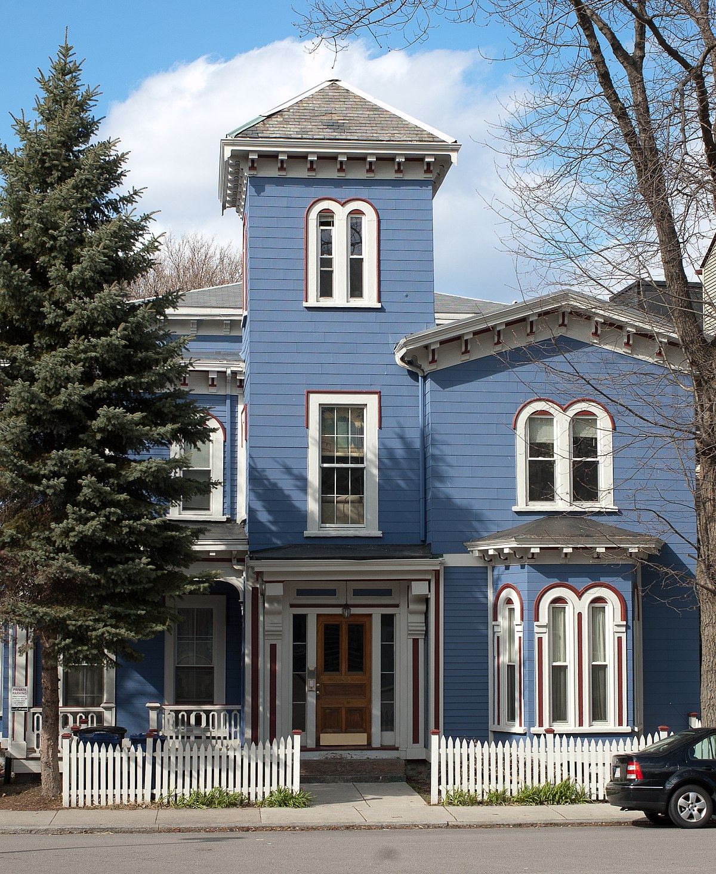

California Housing Data Story
Project 3 / DBCUWA :
Machine Learning, Statistics, Visualization
This Photo by Unknown Author is licensed under CC BY-SA

Slide 2


Project Roadmap
Data check prepare
Visualization
Presentation
Statistics analysis
Machine Learning Analysis

Slide 3


California Housing Dataset
Number of Instances: 20640
Number of Attributes: 8 numeric
Number of Target: 1 numeric
Source : Scikit Learn Database

Slide 4
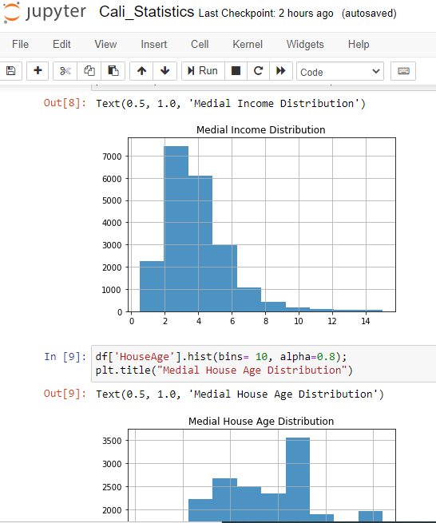

Fully Features’ Correlation & Statistics Analysis Conducted
Each Feature’s Histogram Presented;
Full set statistics parameters For Each Feature calculated;
All features Correlation Matrix Presented.

Slide 5
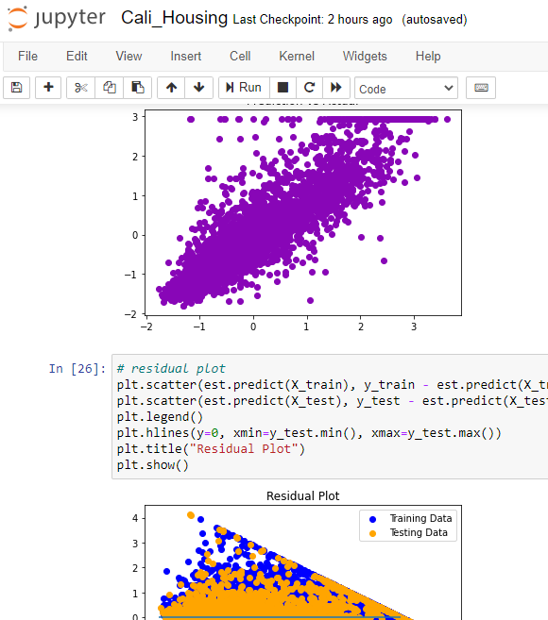

6 Machine Learning Models Deployed with Highest Test R2 Score 0.84 Achieved
Training : Test = 0.8 : 0.2
LinearRegressor;
Lasso, ElasticNet, Ridge;
MLPRegressor;
HistGradientBoostingRegressor

Slide 6
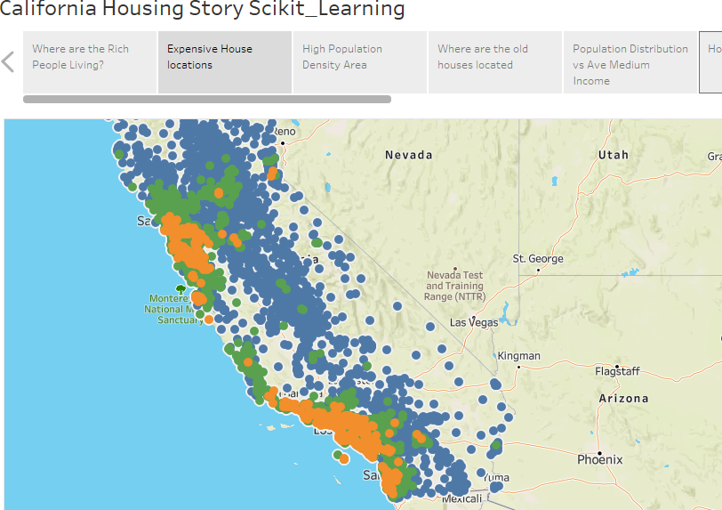

Detailed Data Story Visualized
With Tableau

Slide 7




This Photo by Unknown Author is licensed under CC BY-SA-NC

